Slide 1

Intestinal Flukes
1- Family: Echinostomatidae: Echinostoma spp.
Phylum: Platyhelminthes
Class: Trematodes
Subclass: Digenea
Order: Echinostomatiformes
Family: Echinostomatidae
Genus: Echinostoma
Species: E. revolotum

Slide 2
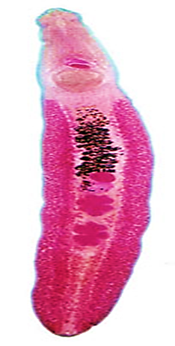


Slide 3
Intermediate host: First: snails, Second: Fishes, tadpoles, Planaria
Final host: Birds
Site of Infection: Intestine
Tend to be relatively non-host specific in semi-aquatic vertebrates. Many species elongate; anterior sucker and large acetabulum anterior, 27-51 circumoral collar of spines, depending upon species
Life-cycle
Adults in gut, eggs passed in feces, hatch; miricidia penetrate snails , for instance, sporocyst; two redia, cercaria, metacercaria in molluscs, planaria, fish, tadpoles, etc. eaten by definitive host

Slide 4
Typical species
A. Echinostoma caproni (in mammalian and avian hosts; Africa)
B. Echinostoma trivolvus (in mammalian and avian hosts; North America)
C. Echinostoma revolutum ( in mammals and birds; Europe and Asia)

Slide 5
Order: Paramphistomiformes
This order often placed as a superfamily of the order Echinostomatiformes. Composed of amphistomes (acetabulum at or near posterior end). Usually thick, fleshy worms. Ovary usually post-testicular
2- Family: Paramphistomidae: Paramphistomum cervi
Phylum: Platyhelminthes
Class: Trematodes
Subclass: Digenea
Order: Paramphistomatiforms
Family: Paramphistomidae
Genus: Paramphistomum sp.

Slide 6
Pathogenic; in large numbers can cause intestinal ulceration and death; secondary bacterial infections
Life-cycle
Adults in rumen, eggs out with feces, mature in water to miricidium hatches; penetrates multiple genera of snail hosts, one sporocyst and two redial generations, cercaria encyst on aquatic vegetation, eaten by herbivore, excyst in duodenum; penetrate gut; migrate through tissues to abomasum, enter lumen and migrate anteriorly to rumen, mature in 2-4 months.

Slide 7
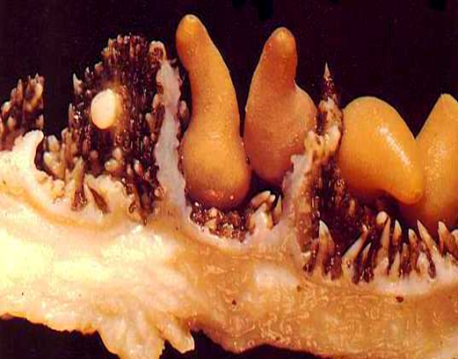
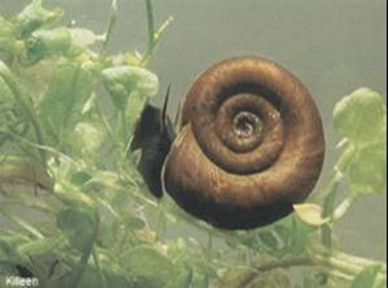
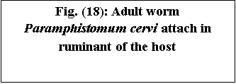


Slide 8
Treatment:
It can be use the drug Hexachloroethan or Pentonine for treat the infected animals as 180 gr./kg. body weight, and using mollescicide as a chemical control to kill the snails ( intermediate hosts).

Slide 9
THANK YOU

